Slide 1
DATA ANALYTIC AND VISULATION OF SUPER MARKET
MOHAMMED KHUBABE.S (610819104028)
RABBANI.S (610819104036)
SUBASH.M (610819104049)
Name of the Guide : Dr. N. SHUNMUGA KARPAGAM
Date of Review : 21.06.2022
Domain : DATA VISULATION

Slide 2
ABSTRACT

Slide 3
The project "DATA ANALYTICS AND VISUALIZATION OF SUPER MARKET USING TABLEAU" is mainly designed to visualize and analyze the Super Market available across United state that offers the details about variety of products.
This is the software requirement specification for analysis and visualizing the top products in United state using Tableau.
This DATA ANALYTICS AND VISUALIZATION OF SUPER MARKET USING TABLEAU is built for the sake of ensuring efficiency and clear data saving and manipulation as well as neat work on the visualization.
The summarized view of details can be viewed for monitoring purpose.
We can be well maintained the data up to date.
This software is user-friendly so you can easily understand the fundamentals of software.

Slide 4
SYSYEM REQUIREMENTS
Operating Systems
Windows
Microsoft Windows 8/8.1, Windows 10 (x64)
2 GB memory
1.5 GB minimum free disk space
CPUs must support SSE4.2 and POPCNT instruction sets
Mac
macOS Mojave 10.14, macOS Catalina 10.15, and Big Sur 11.4+
Intel processors
M1 processors under Rosetta 2 emulation mode
1.5 GB minimum free disk space
CPUs must support SSE4.2 and POPCNT instruction sets

Slide 5

SOFTWARE USED FOR VISUALIZATION
Tableau is a visual analytics platform transforming the way we use data to solve problems empowering people and organizations to make the most of their data.
Tableau helps people and organizations become more data-driven with the most beloved modern analytics platform in the world.

Slide 6
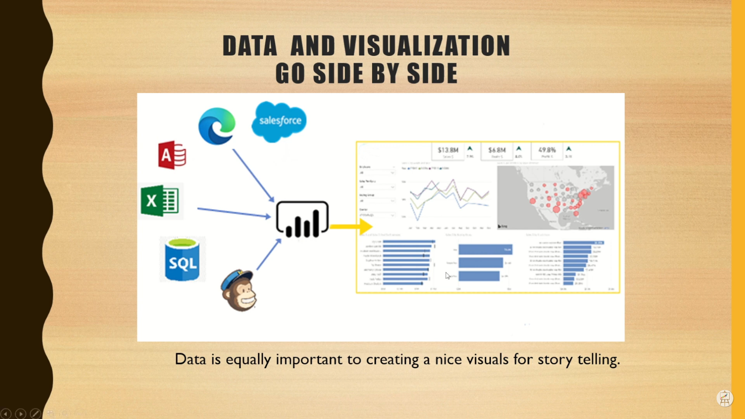
DATA AND VISUALIZATION GO SIDE BY SIDE
Data is equally important to creating a nice visuals for story telling.

Slide 7
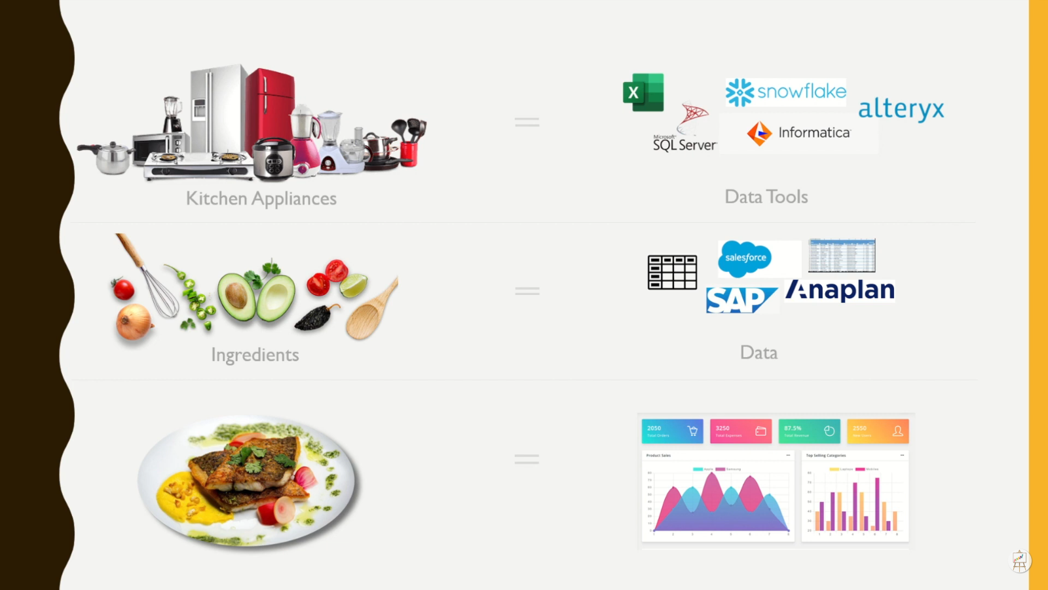
UNDERSTANDING IMAGE

Slide 8
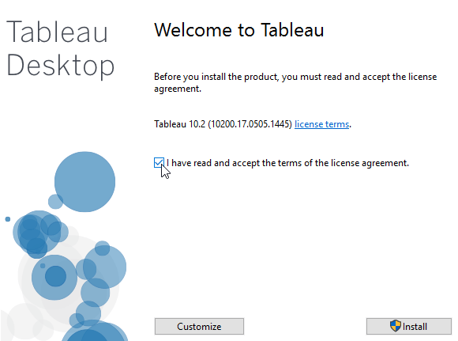
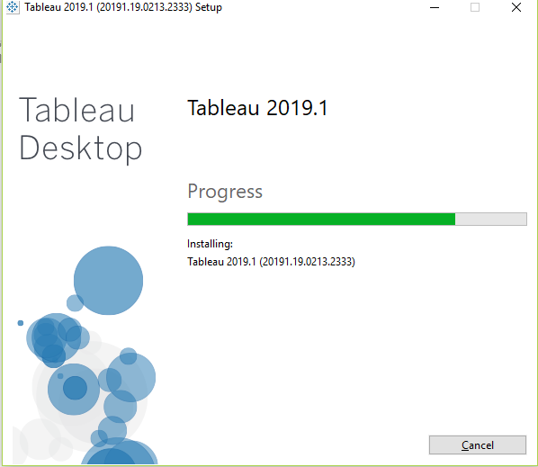
SOTWARE INSTALLATION

Slide 9
DATA SOURCES
Connect to these data sources with Tableau Desktop Public Edition.
Google Sheets
JSON files
Microsoft Excel 2007 or later
OData
PDF
Spatial files (Esri Shapefiles, KML, GeoJSON, and MapInfo file types)
Statistical Files; SAS (*.sas7bdat), SPSS (*.sav), and R (*.rdata, *.rda)
Text files -- comma separated value (.csv) files
Tons of web data with the Web Data Connector

Slide 10
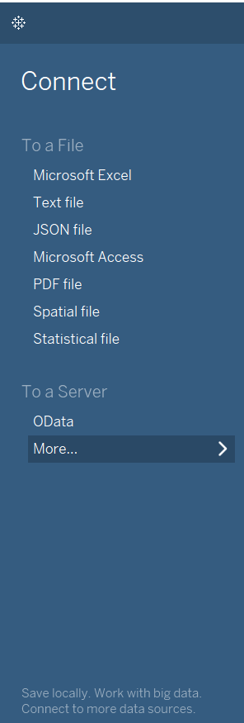
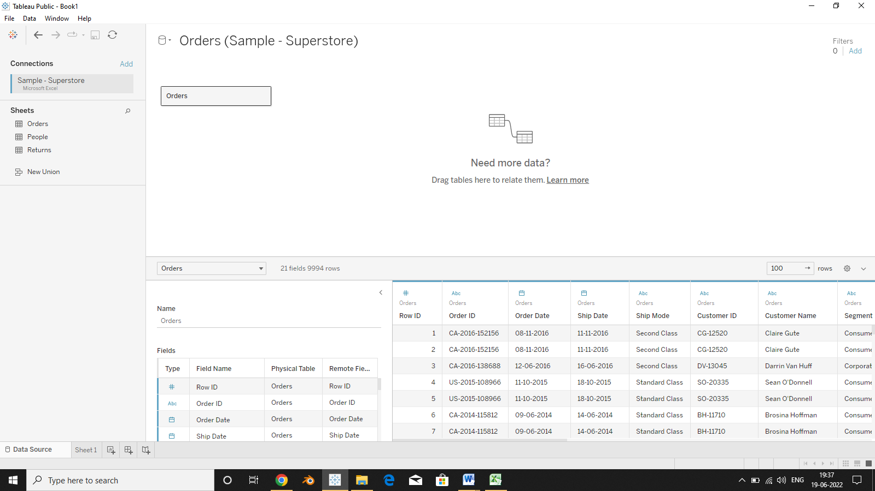
CONNECTING TO DATA

Slide 11
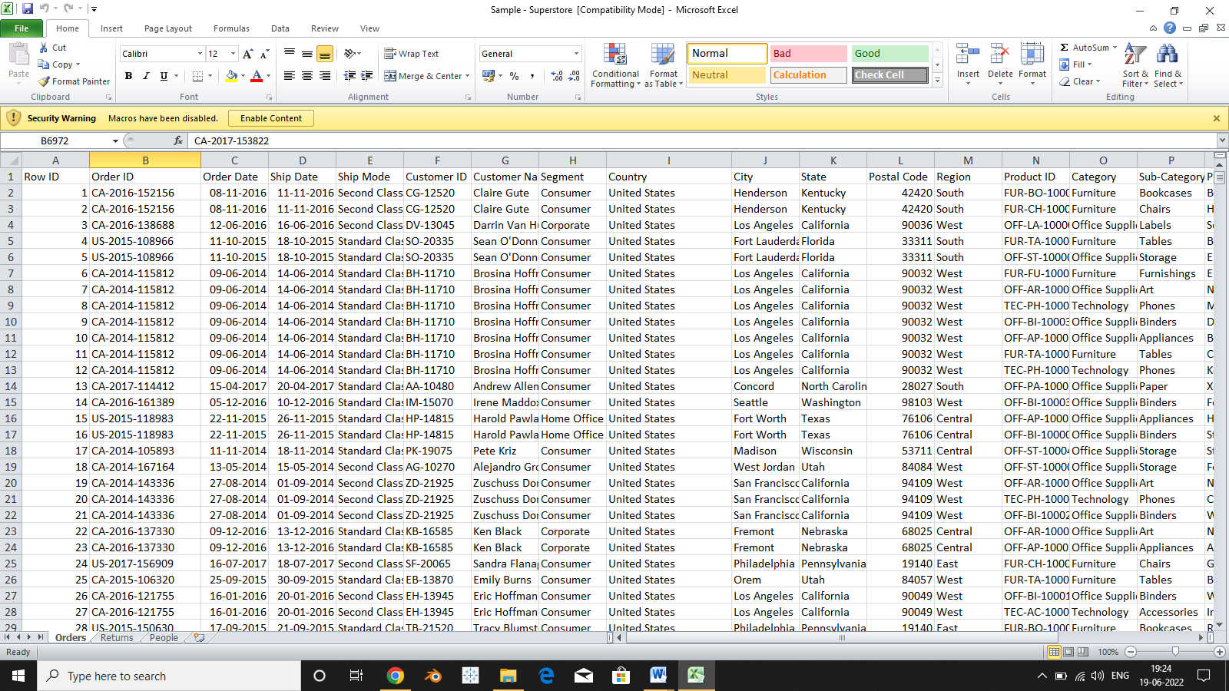
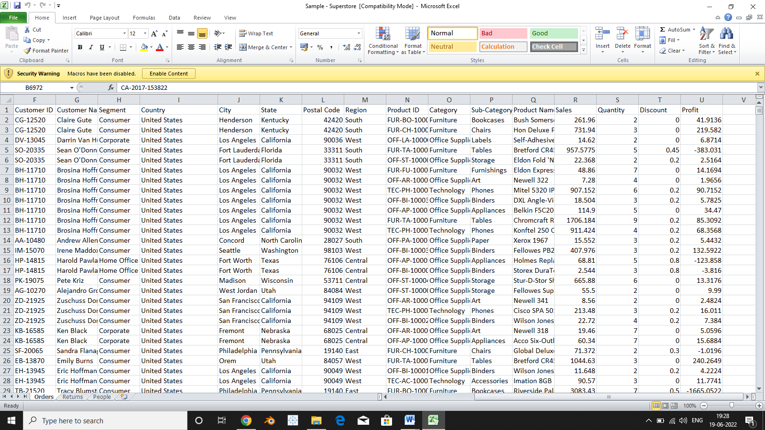
SAMPLE DATASET OF SUPER MARKET

Slide 12
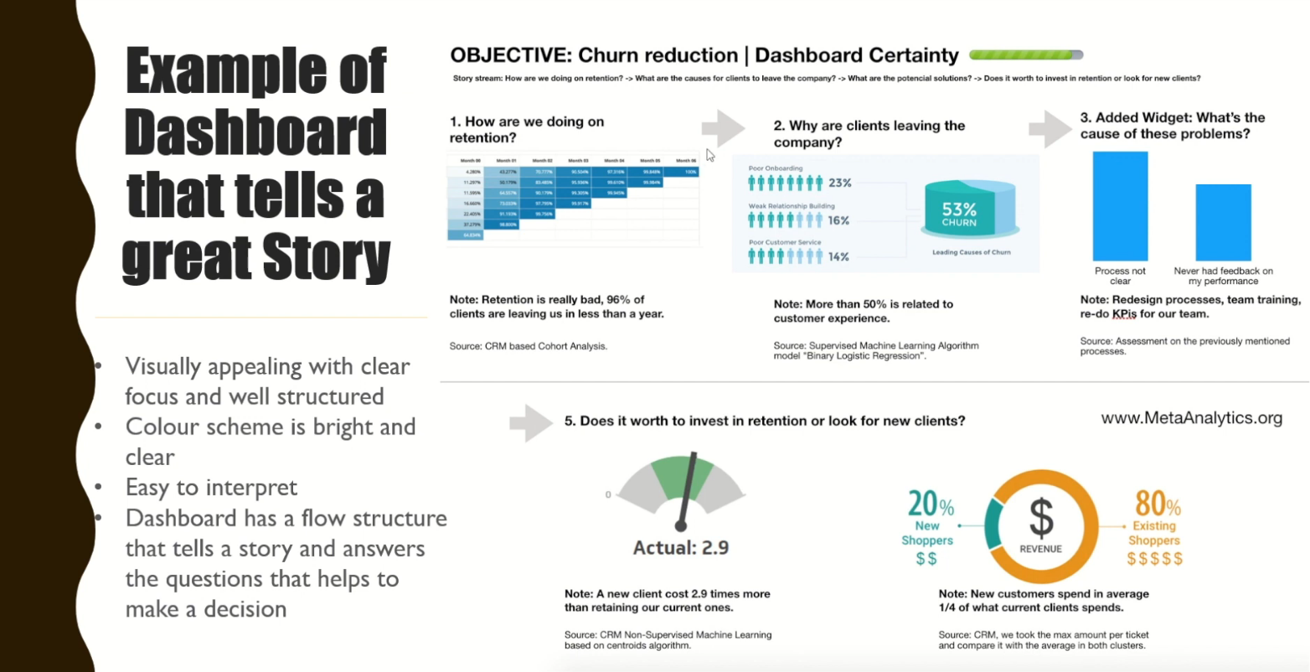
PROJECT IMPLEMENTATION

Slide 13
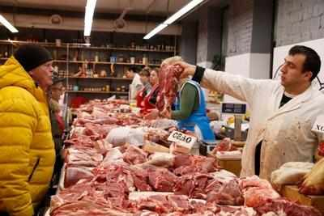
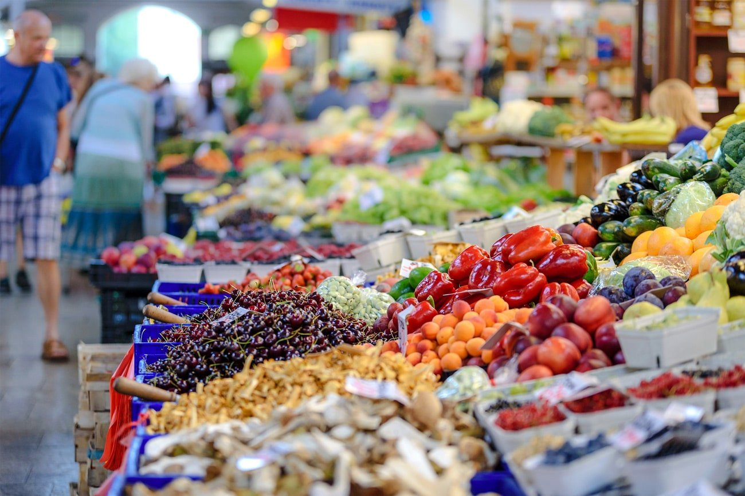
DIFFERENT PRODUCTS AVALILABLE IN US

Slide 14
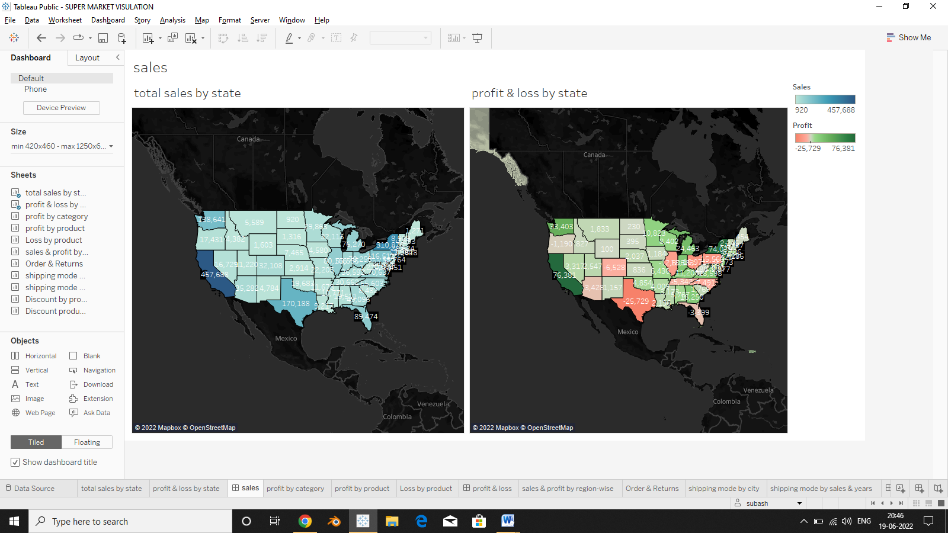
SALES

Slide 15
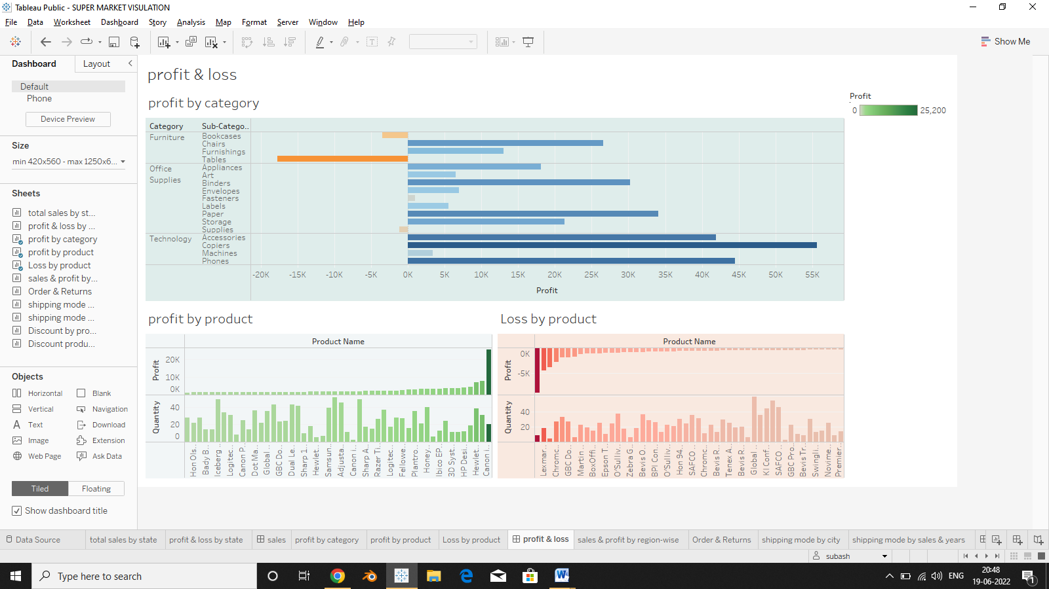
DASHBOARD PROCESS
PROFIT & LOSS

Slide 16
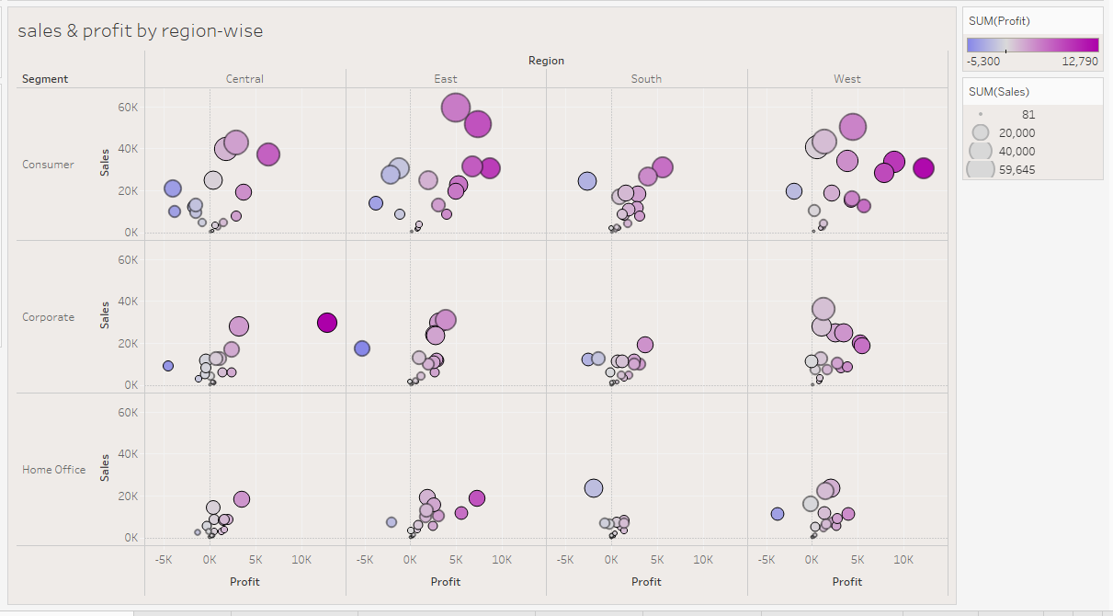
SALES & PROFIT BY REGION-WISE

Slide 17
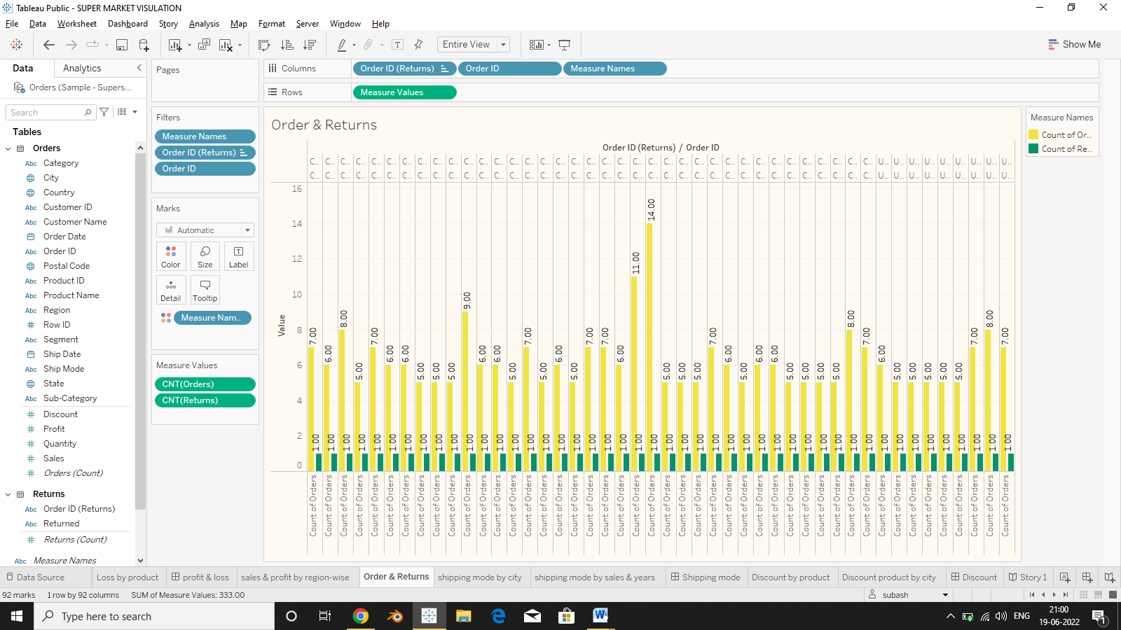
ORDER & RETURNS

Slide 18
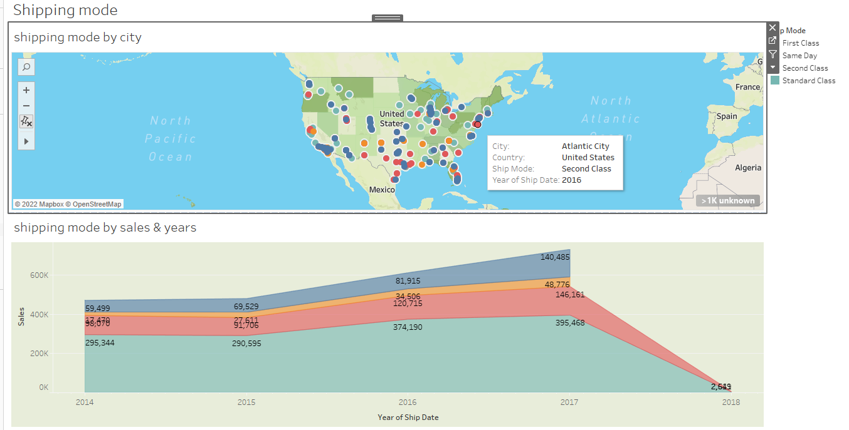
SHIPPING MODE

Slide 19
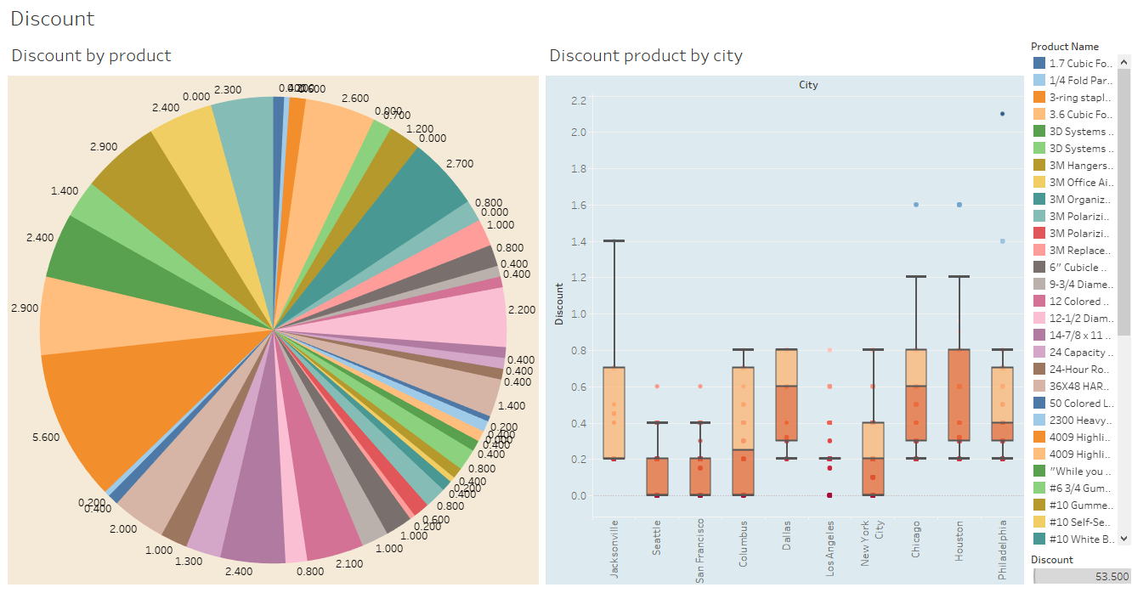
DISCOUNT

Slide 20
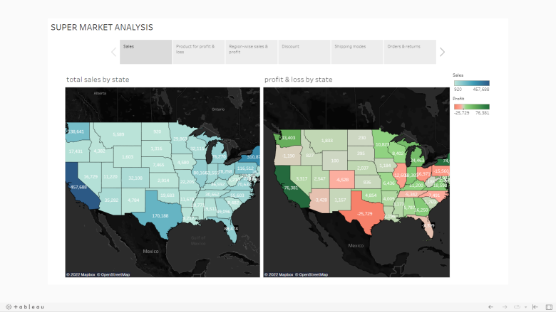
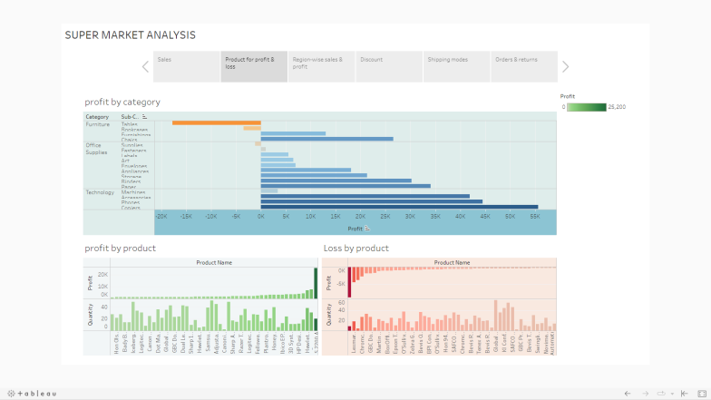
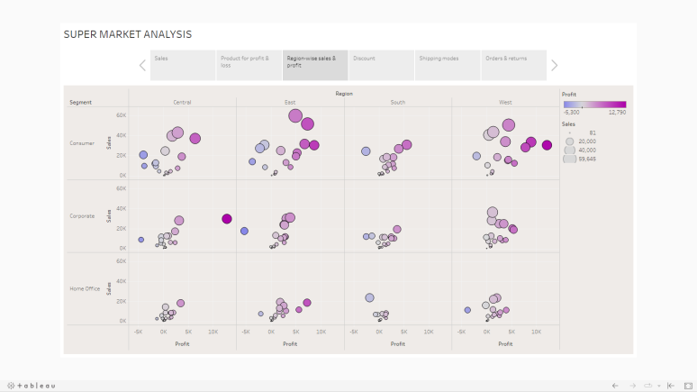
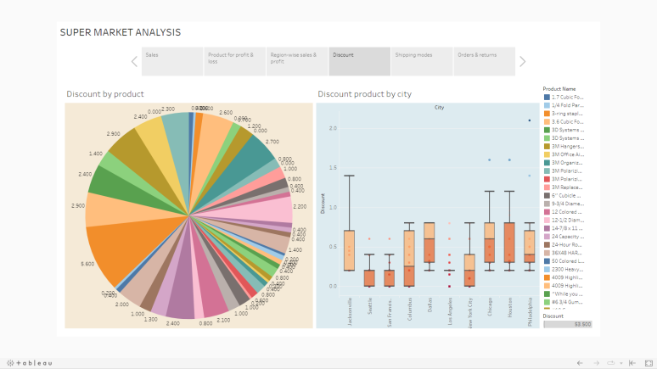
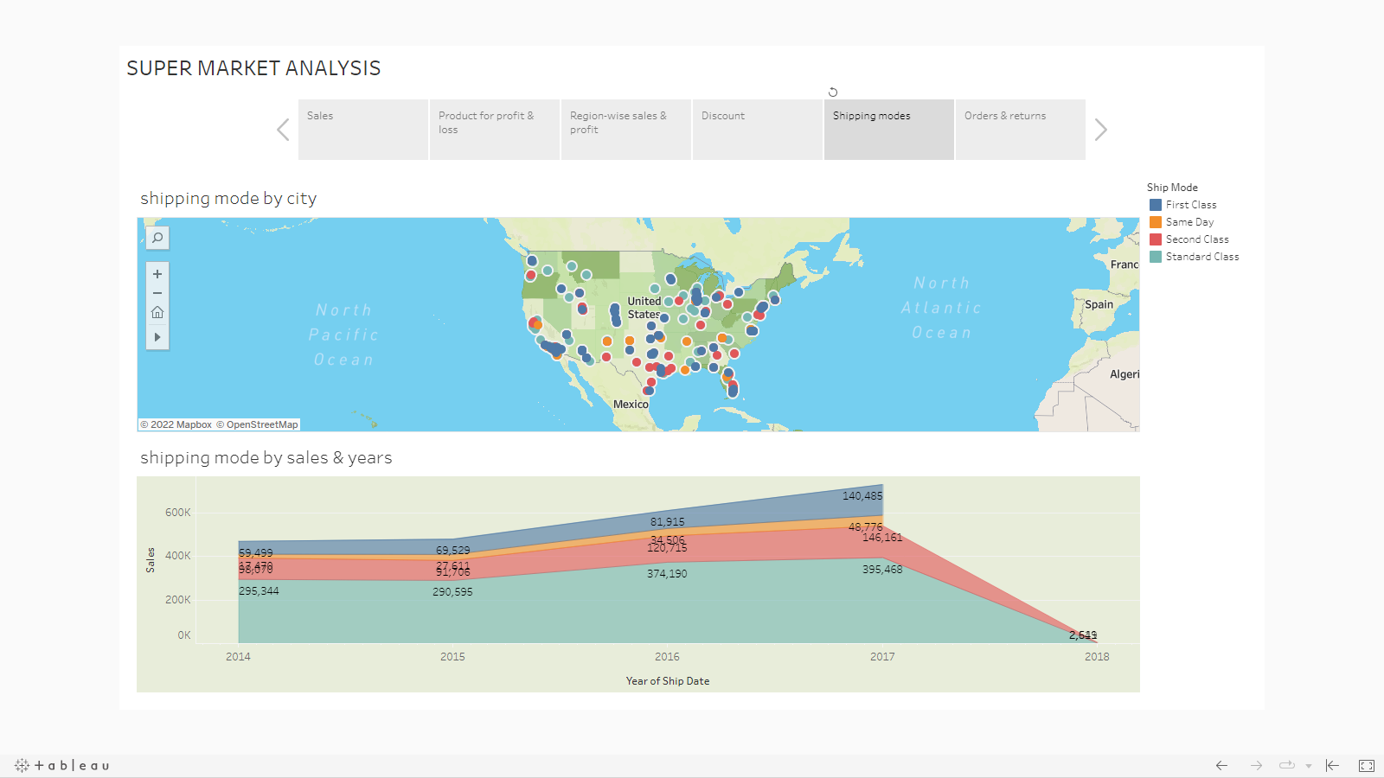
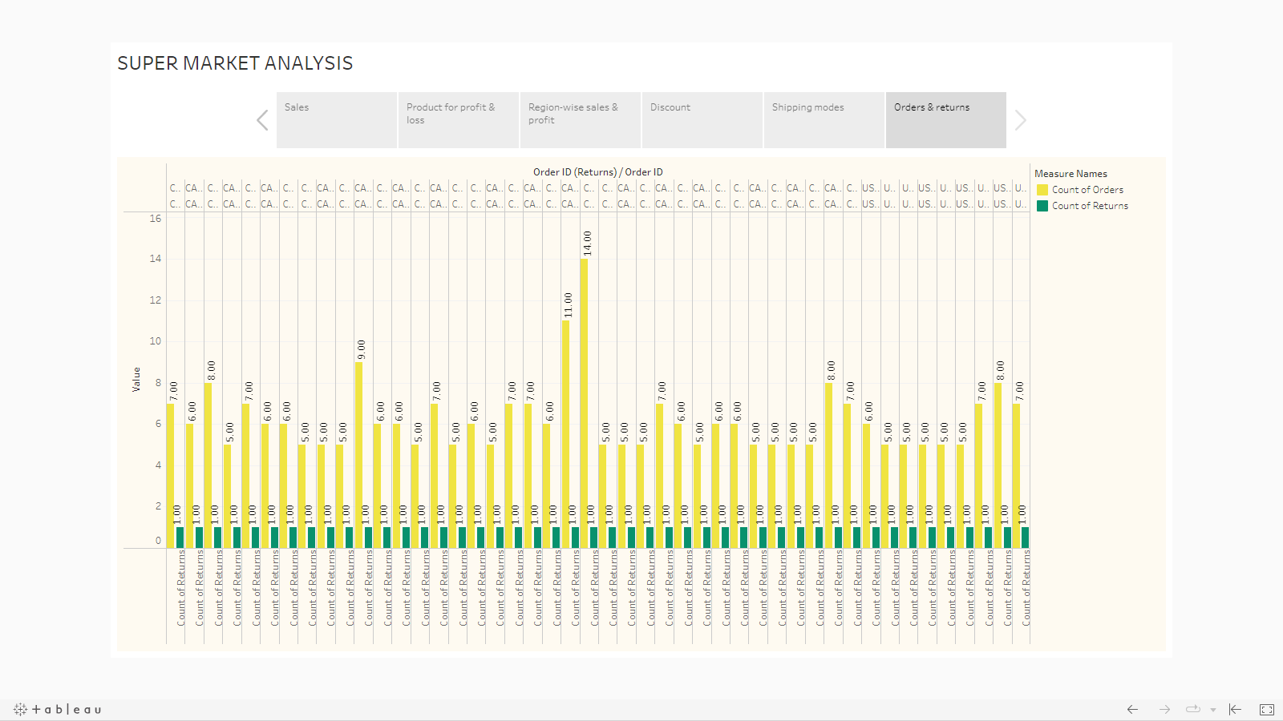
STORY

Slide 21
CONCLUSION
CONCLUSION
Thus, the project on "DATA ANALYTICS AND VISUALIZATION OF SUPER MARKET USING TABLEAU” was completed with front end as tableau public 2019 successfully. The main purpose of this project is visualizing the given data and analyze it through pictorial representations. Hence the admin can access, manipulate and update the data according to his needs.
The project which we have developed is very convenient to use any user. Our project has all the features to facilitate the major operation of manipulating data. Security has been provided to the authorized person. Here admin have full rights to modify all details in the project.
FURTHER ENHANCEMENTS
As US Super market is consisting of a variety of products and category provide on overall country, there will be a discovery of several products and category over years. So according to the new availability products or category are available the authorized person will give the best analysis to the user.

Slide 22
REFERENCES
[1] https://www.kaggle.com/code/akpflow/super-market-analysis/data
[2] https://simple.wikipedia.org/wiki/Supermarket
[3] https://drive.google.com/file/d/11gs4UgN9qBHc7JsI9E7jZN5FkAEu4XgK/view
[4] https://www.kaggle.com/datasets/aungpyaeap/supermarket-sales
[5] https://community.tableau.com/s/question/0D54T00000CWeX8SAL/sample-superstore-sales-excelxls

